Slide 1
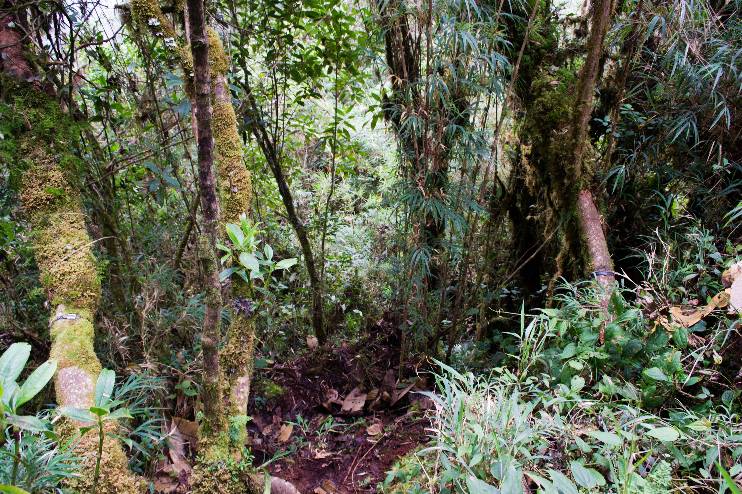

Can forest structure affect elevational range shifts?
John Godlee
Pippa Stone, Dr. Caroline Nichol

Slide 2




Climate change & range shifts
Climate
change
Morphology
Guerin et al. 2012
Adaptation
Acclimation
Phenology
Richardson et al. 2013
Physiology
Hoffmann & Śgro 2011
Spatially dependent mortality/recruitment
Elevation
Range shifts
Latitude
Chen et al. 2011
Notes:
2

Slide 3
Bioclimatic envelope models
Current species distribution
Climate data
Bioclimatic envelope
Climate predictions
Predicted species range
Pearson & Dawson 2003

Slide 4
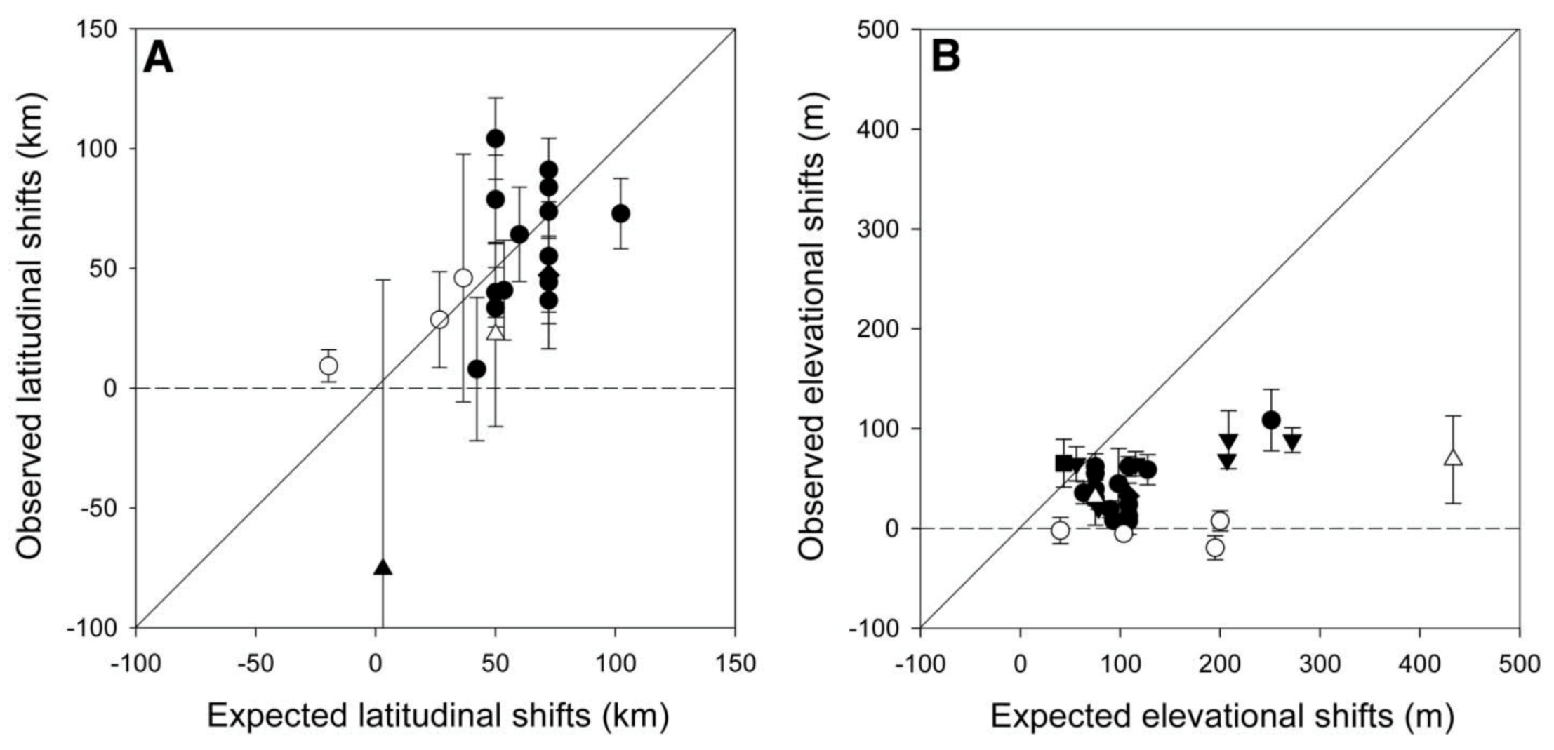
Models fail to predict elevation shifts
Mean range shift ± 1 S.E.
Latitudinal Range Shifts
Elevational Range Shifts
Birds
Arthropods
Mammals
Molluscs
Plants
Herptiles
Fish
Chen et al. 2011
Notes:
4

Slide 5


Temp. variation
Other variables change with elevation
Herbivory
Elevation
Nutrient Availability
Low
High
Soil depth
UV-B Damage
Whitaker et al. 2014,
Nottingham et al. 2015

Slide 6
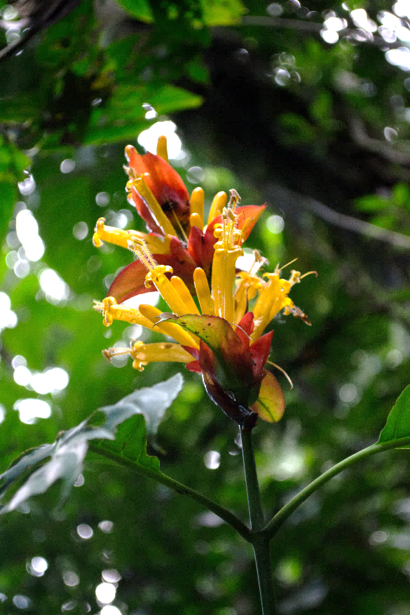
Research question
Can forest structure explain variation in plant stress?
Should forest structural variables be included in range shift models to improve their accuracy?
?

Slide 7
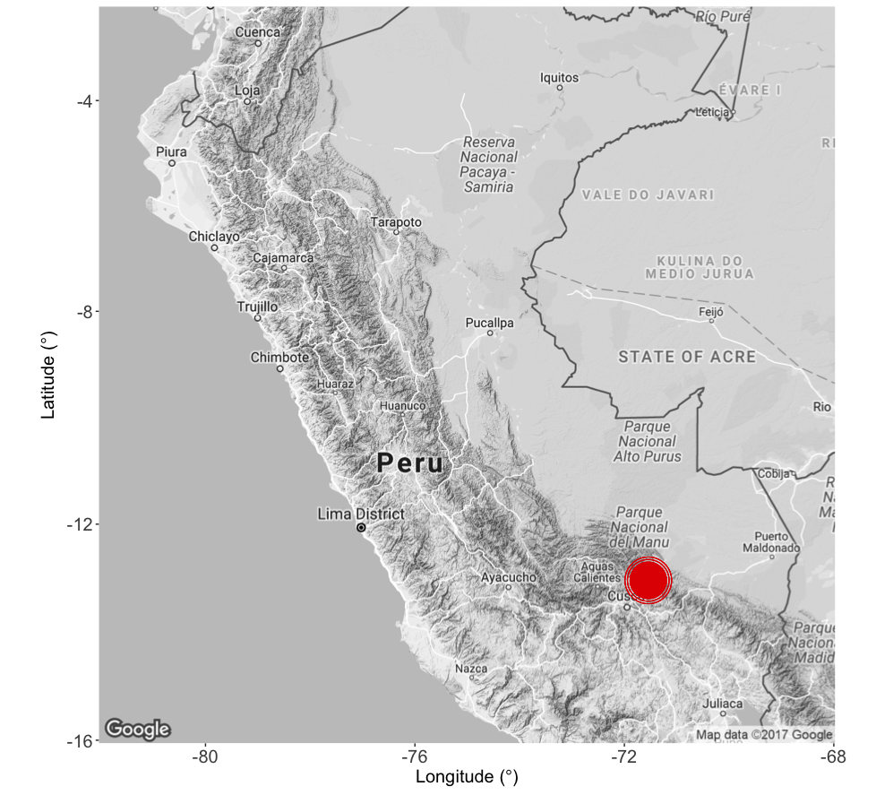
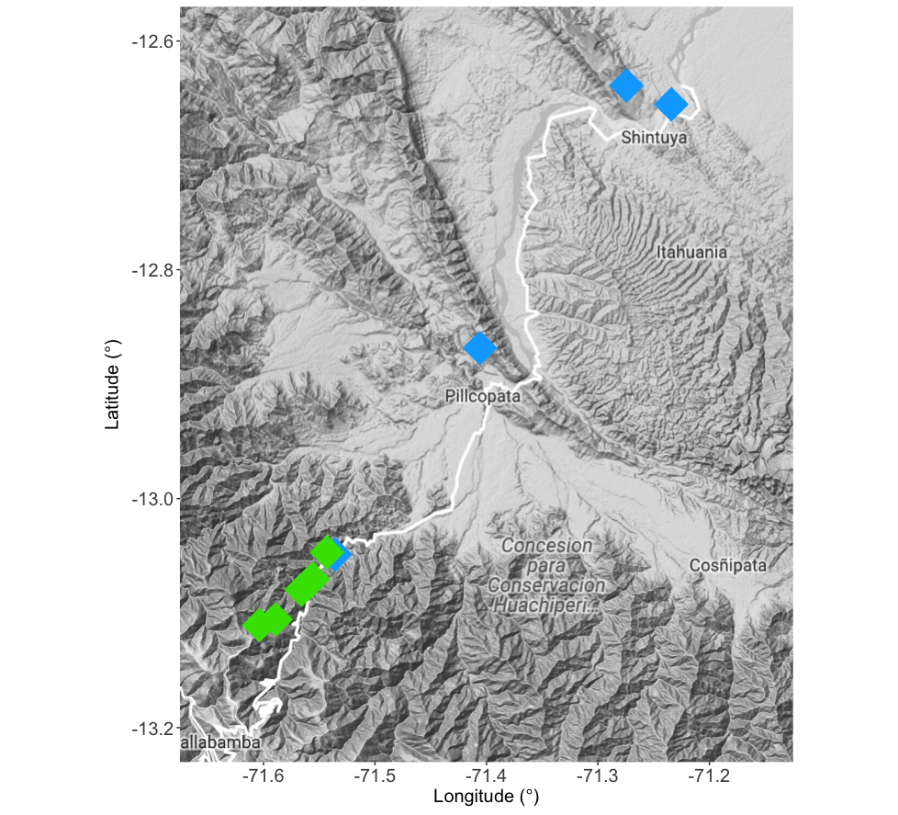
Study site
< cloud base
> cloud base
Notes:
7

Slide 8
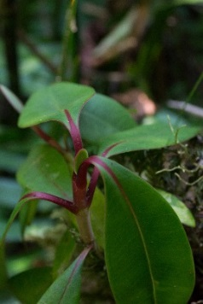
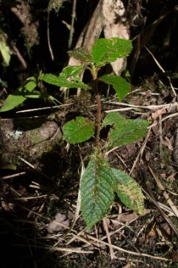
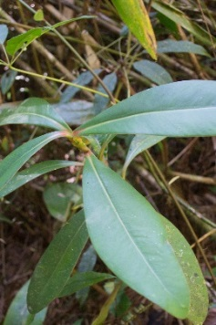
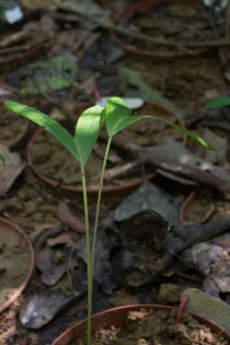
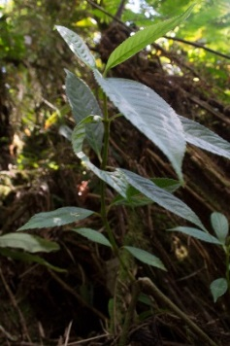
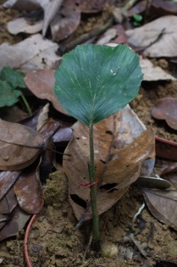
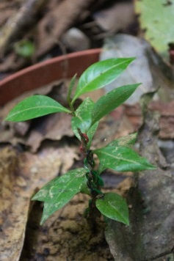
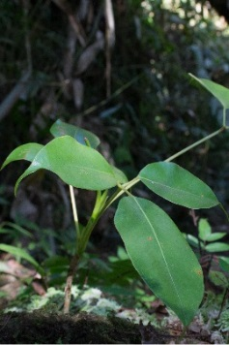
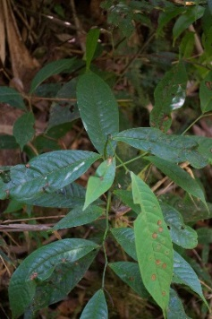
Study species
Range Limits
Upper
Middle
Lower
Site
Alzatea verticillata
Clethra
revoluta
Clusia
thurifera
Dictyocaryum
lamarckianum
Hedyosmum
goudotianum
Iriartea
deltoidea
Myrcia
spp.
Schefflera
patula
Tapirira
guianensis
Notes:
8

Slide 9

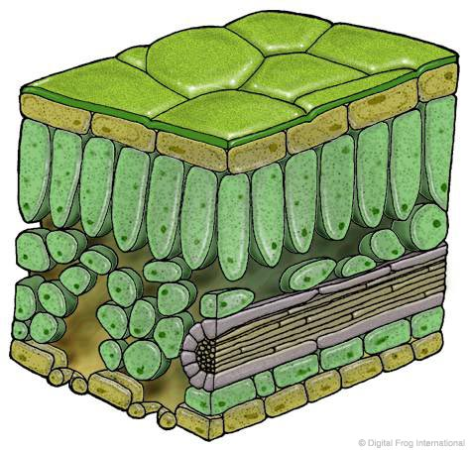
Stress – Chlorophyll fluorescence & content
Healthy Plant – photosynthetic efficiency (F_{v}/F_{m}) ~ 0.8
Light
Fluorescence
Heat
PSII
Photosynthesis
Chlorophyll fluorescence using a
MINI-PAM-II fluorometer

Slide 10
Stress – Chlorophyll fluorescence & content
Stressed Plant – photosynthetic efficiency (F_{v}/F_{m}) < 0.7
Light
Fluorescence
Heat
PSII
Chlorophyll fluorescence using a
MINI-PAM-II fluorometer

Slide 11
Forest Structure
Adult-Seedling Interactions
Canopy Density
Root Competition
Seedling-Seedling Interactions
Seedling Abundance
Canopy Density
Seedling
Abundance
Root
Competition
Notes:
11

Slide 12
Statistical analysis – effect of forest structure
Response
Fixed Effect
Random Effects
~
Elevation
Root Competition
Canopy Density
Seedling Abundance
+ (Plot) + (Species)
Photosynthetic Efficiency
Chlorophyll Content

Slide 13
Statistical analysis – effect of forest structure
Response
Fixed Effects
Random Effects
~
+
+
+
+ (Plot) + (Species)
Best quality model chosen using:
AIC (Akaike Information Criterion)
Pseudo-R-squared (Barton 2015)
Model validation using:
Variance Inflation Factors
Predicted vs. observed values

Slide 14
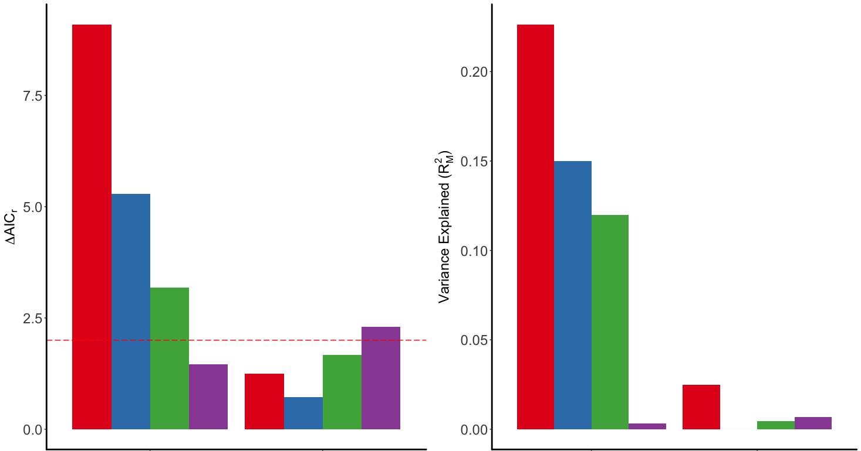
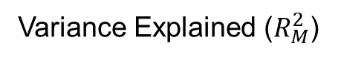
Results – effect of forest structure
Model Quality (ΔAIC)
Variance Explained ($R_{M}^{2}$)
Fixed Effect
Elevation
Root Comp.
Canopy Density
Seedling Abundance
ΔAIC_{r} = 2
Photosynthetic Efficiency
Chlorophyll content
Photosynthetic Efficiency
Chlorophyll content
Notes:
14

Slide 15

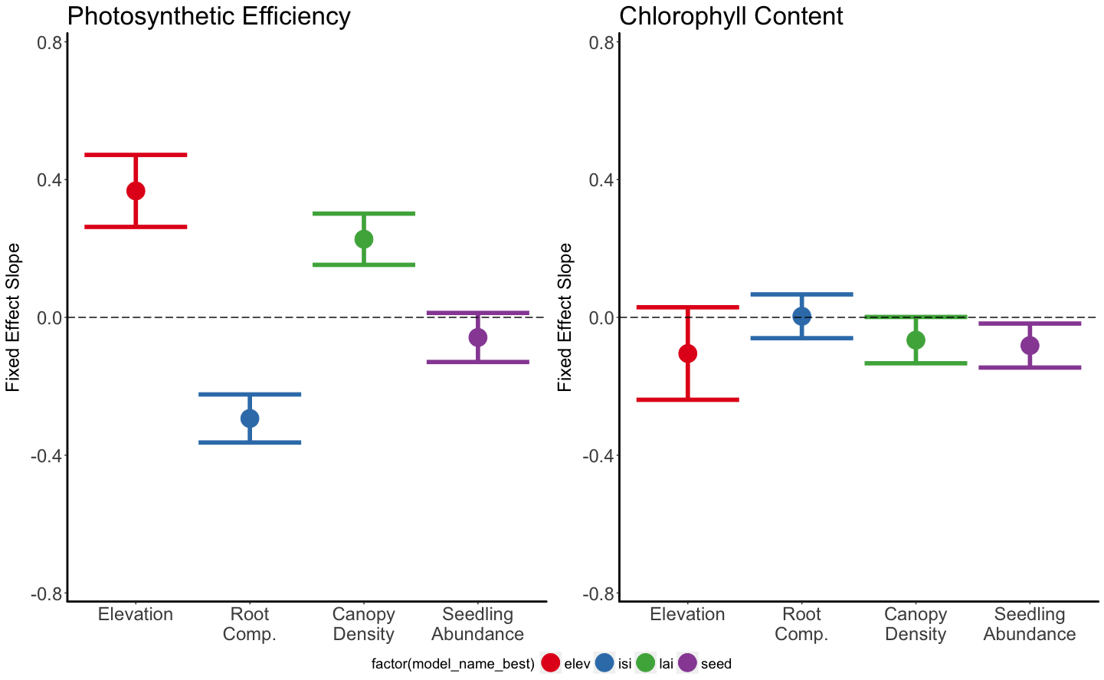
Results – effect of forest structure
Photosynthetic Efficiency
Chlorophyll Content
Slope ±
1 S.E.M.
Elevation
Root Comp.
Canopy Density
Seedling Abundance

Slide 16
Results – Best Model
Response
Fixed Effects
Random Effects
Photosynthetic
Efficiency
~
+
+
+ (Plot) + (Species)
R² = 0.56
Chlorophyll Content
~
N/A
+ (Plot) + (Species)
R² = 0.004

Slide 17
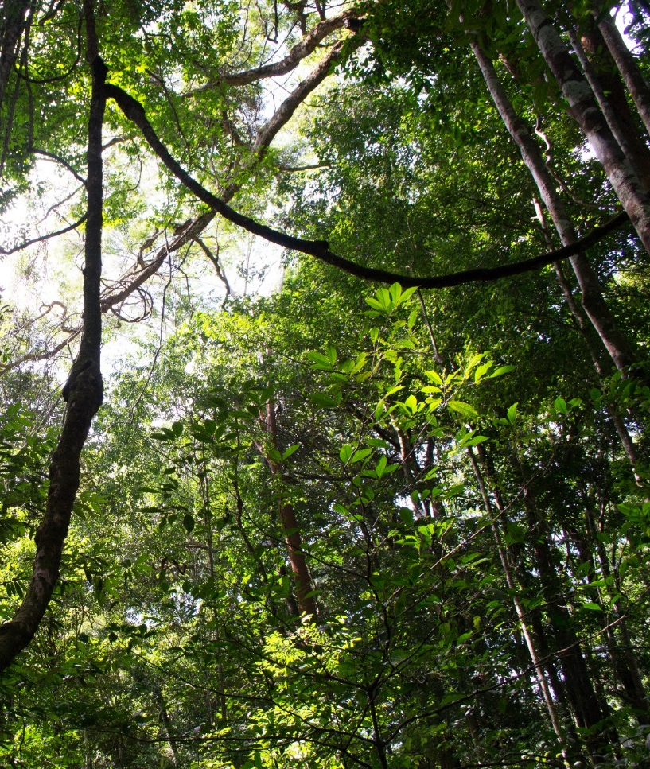
Summary
Adult-seedling interactions affect seedling stress.
No forest structure parameters had a greater effect than elevation.
Photosynthetic efficiency best predicted by elevation and adult-seedling interactions.
Cloud forest transition could be a barrier to upslope migration.

Slide 18
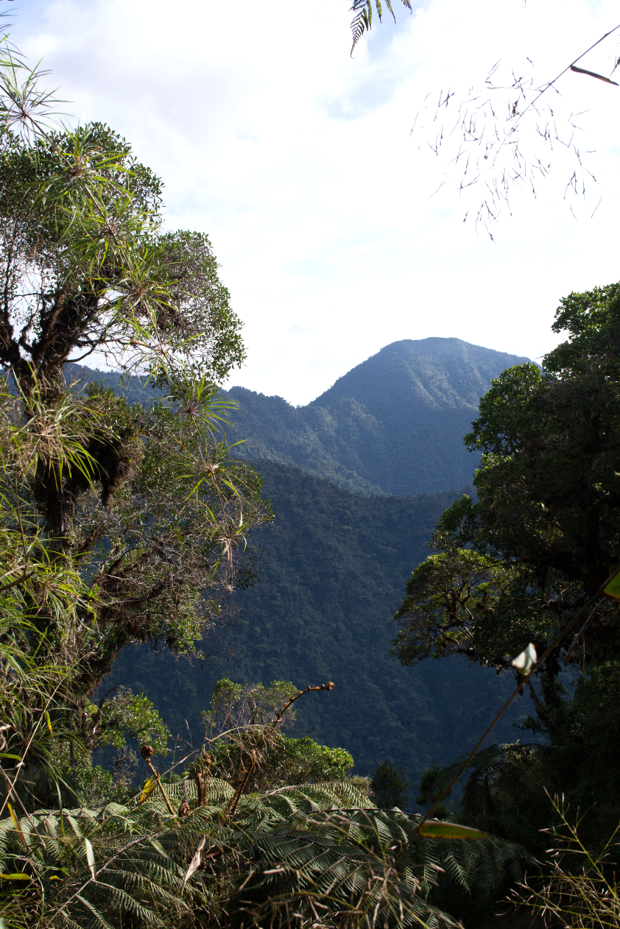
Future Studies
Transplant experiments
Extended genotype
Fungal pathogens
Herbivory
Compare with other biomes
Rare species
Rare species react differently (Lyons et al. 2005, Mouillot et al. 2013)
Collect forest structure data!
Remote sensing
Drones

Slide 19
References
Barton K. (2015). MuMIn: Multi-Model Inference. http://CRAN.R-project.org/package=MuMIn.
Chen I.-C., Hill J. K., Ohlemuller R., Roy D. B., & Thomas C. D. (2011). Rapid range shifts of species associated with high levels of climate warming. Science, 333(6045), 1024–1026.
Feeley K. J., Silman M. R., Bush M. B., Farfan W., Cabrera K. G., Malhi Y., … Saatchi S. (2011). Upslope migration of Andean trees. Journal of Biogeography, 38, 783–791.
Guerin G. R., Wen H., & Lowe a. J. (2012). Leaf morphology shift linked to climate change. Biology Letters, 8(5), 882–886.
Hegyi F. (1974). A simulation model for managing jack-pine stands. In Growth models for tree and stand simulation (pp. 74–90).
Hoffmann A., & Sgrò C. (2011). Climate change and evolutionary adaptation. Nature, 470(7335), 479–485.
Larcher W. (2003). Physiological Plant Ecology: Ecophysiology and Stress Physiology of Functional Groups (4th ed.). Berlin: Springer-Verlag.
Mouillot D., Bellwood D. R., Baraloto C., Chave J., Galzin R., Harmelin-Vivien M., … Thuiller W. (2013). Rare Species Support Vulnerable Functions in High-Diversity Ecosystems. PLoS Biology, 11(5).
Nottingham A. T., Turner B. L., Whitaker J., Ostle N., McNamara N. P., Bardgett R. D., … Meir P. (2015). Soil microbial nutrient constraints along a tropical forest elevation gradient: a belowground test of a biogeochemical paradigm. Biogeosciences Discussions, 12(8), 6489–6523.
Pearson R. G., & Dawson T. P. (2003). Predicting the impacts of climate change on the distribution of speces: are bioclimate envelope models useful? Global Ecology and Biogeography, 12, 361–371.
Whitaker J., Ostle N., Nottingham A. T., Ccahuana A., Salinas N., Bardgett R. D., … McNamara N. P. (2014). Microbial community composition explains soil respiration responses to changing carbon inputs along an Andes-to-Amazon elevation gradient. Journal of Ecology, 102(4), 1058–1071.
All photographs by John Godlee. All illustrations used under a Creative Commons BY-NC license.
Notes:
19

Slide 20
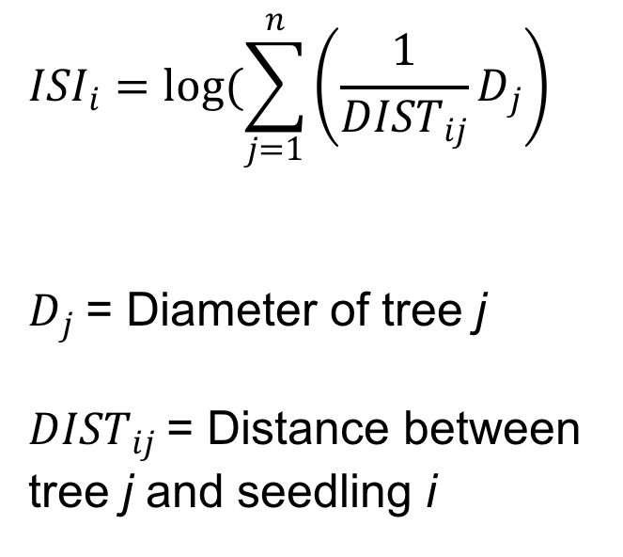
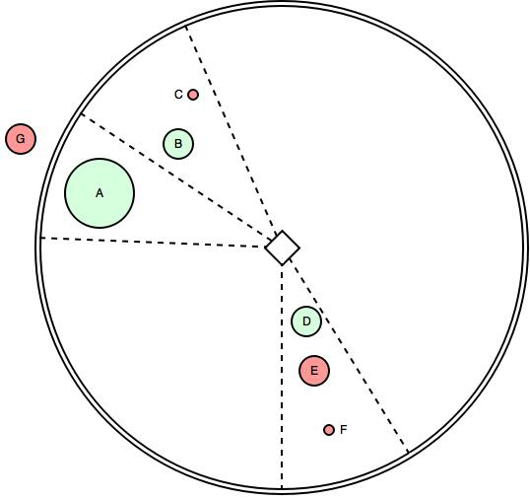
Root Competition – Iterative Seedling Index
Active competitor
Inactive competitor
Seedling
30° zone
Adapted from:
Hegyi 1974

Slide 21
Do species differ in their sensitivity to variation in elevationally dependent environmental variables
Should each species be treated separately in future models?

Slide 22
Statistical analysis – species sensitivity
Response
Fixed Effect
Random Effects
~
+ (Plot) + (Elevation|Species)

Slide 23

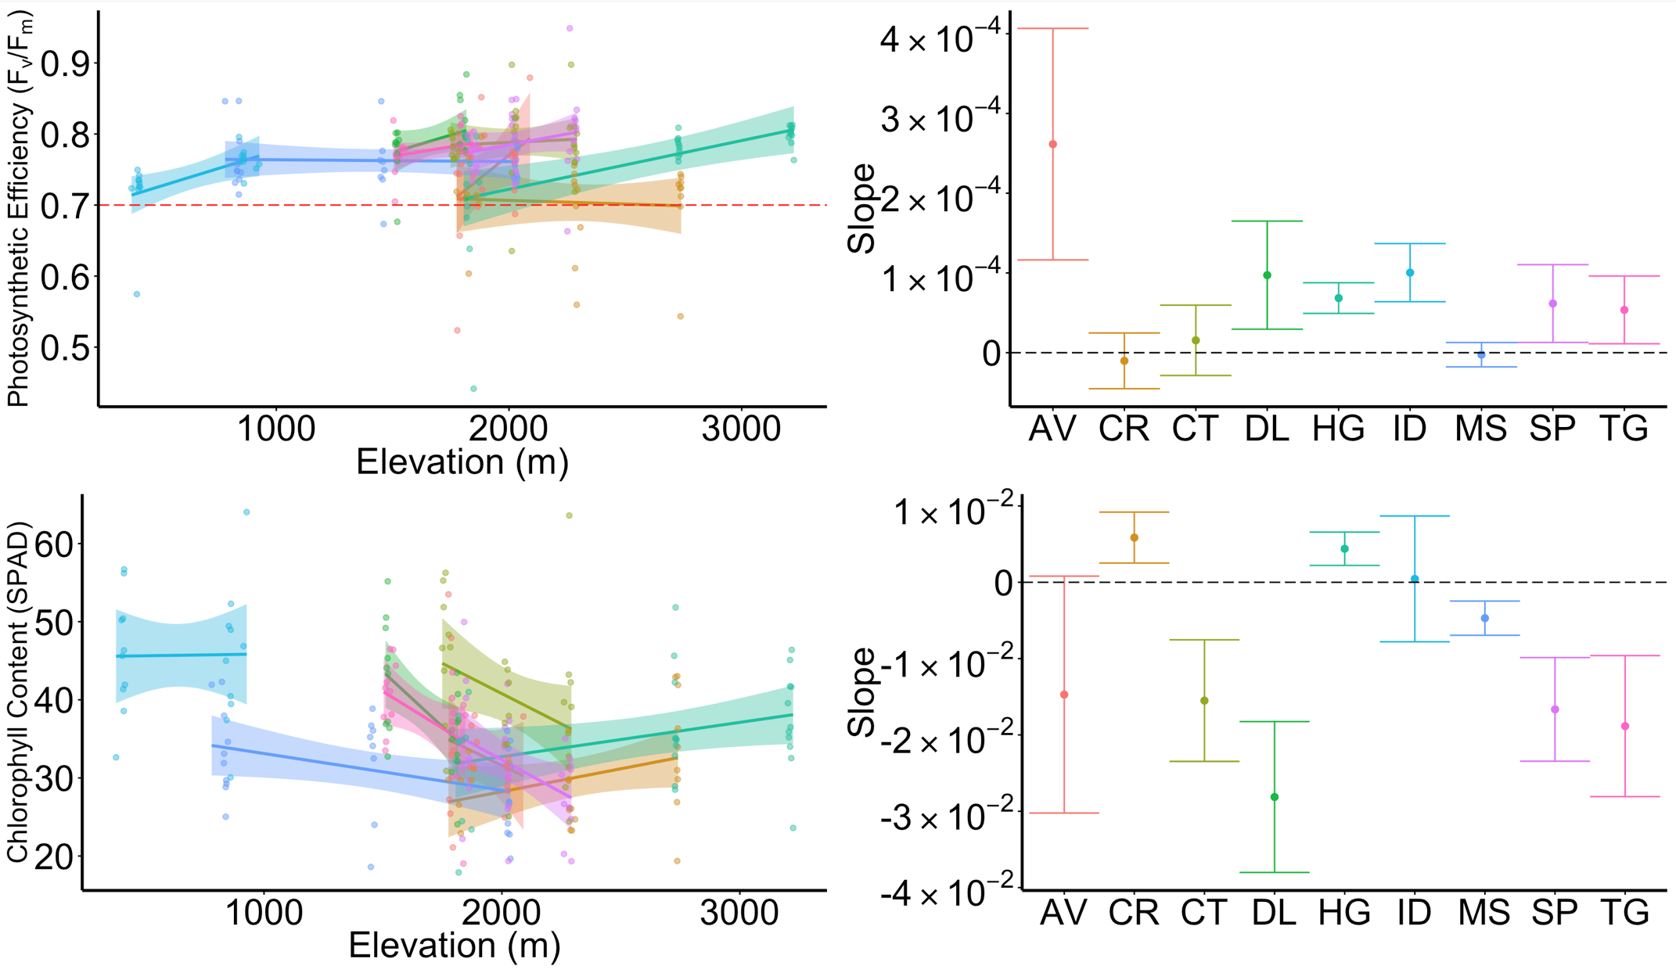
Results – Species sensitivity
Regression ± 95% Confidence Interval
Slope ± 1 S.E.

Slide 24
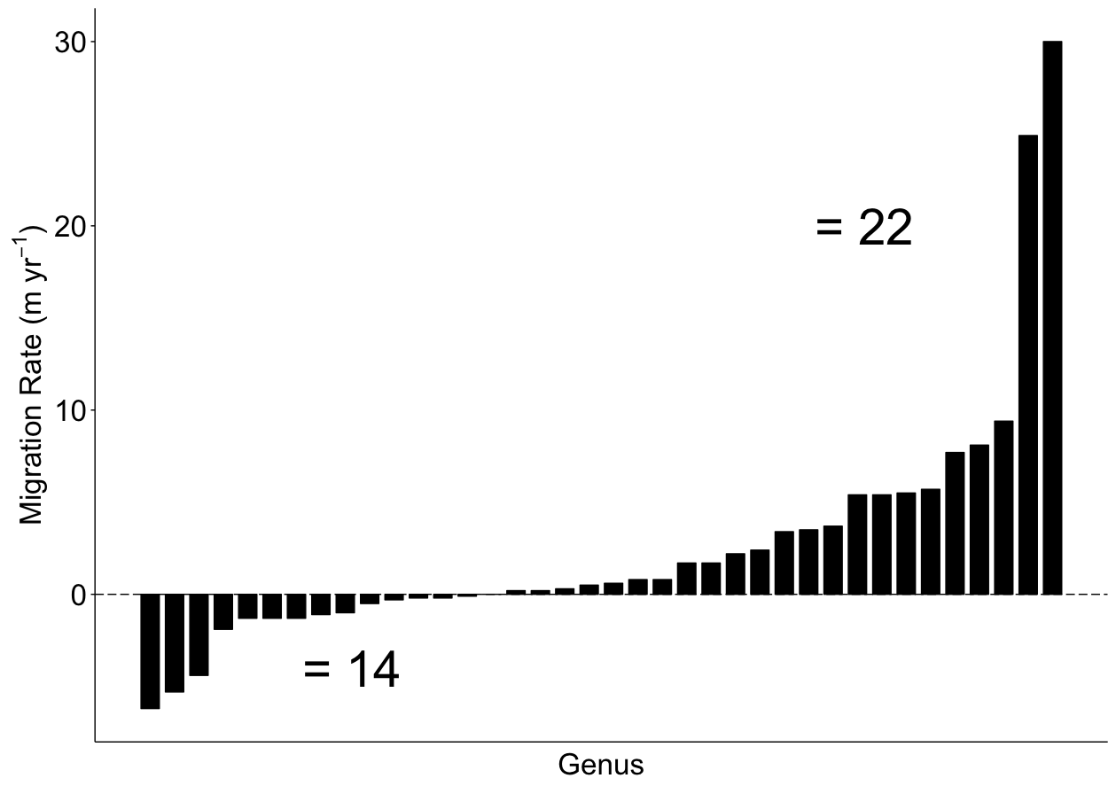
Species differ in their climate sensitivity
Data from:
Feeley et al. 2011

Slide 25
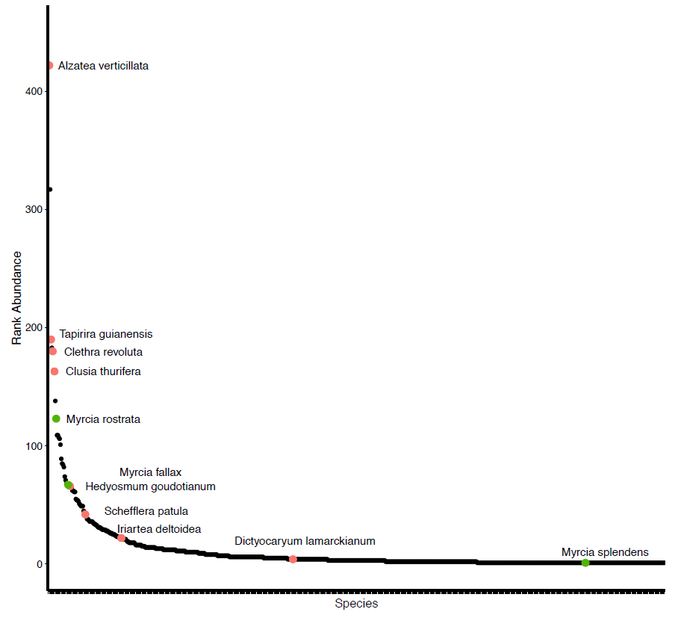
Relative Abundance

